Slide 1
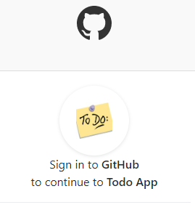
Task Management App with Flask and Single Sign on enabled. https://to-do-app-with-flask-and-sso.herokuapp.com/ Developed by :- Rohit Kurdukar(Rohit.kuru@gmail.com)

Slide 2
Security
Identity Provider – Github.com
Using this method all security related issues will be taken care by GitHub security. User base maintence and password will be handled by GitHub. Application developer can focus on application logic rather than keep worrying about user personal data.
User personal view:
Application logic make sure that user has his/her own view only . He / She cannot view each other tasks
SSL enabled:
Application is deployed on Heroku , that make sure SSL encryption is on the URL , and that makes all traffic in transit encrypted.
Site Admin
Application admin can monitor how many users are currently registered on application and total no of tasks are processed at present.

Slide 3
Cost Effective
Server less Architecture:
Application is deployed on Heroku platform which is server less in nature where no server provision and maintence cost is involved.
In case of heavy traffic , Heroku plans are easy to change but application can be maintenaied as server less application

Slide 4
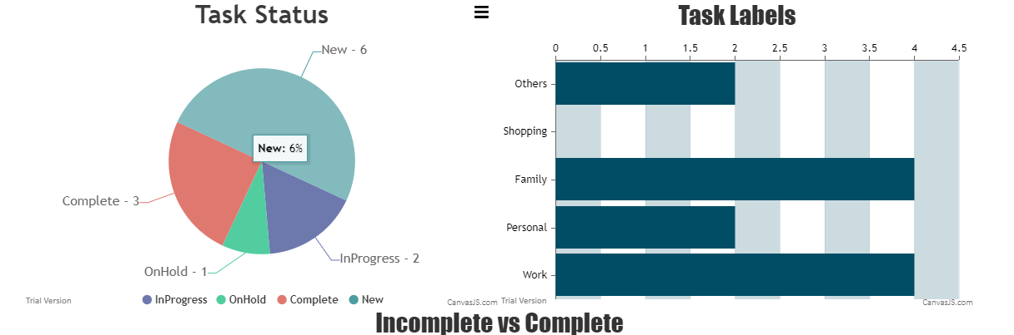
Data Visualization
Data visualization is major part of this application where all user related task can be visualize using graphs like Pie Diagram, Bar Diagram, and Multibar diagram.
Tasks are categorized on basis of label that is assigned to them and their status as well. One click view gives user a summaries view of his/her all current and previous tasks.

Slide 5
Functionality
User can add, edit task in his/her list and assign label, due date as soon as task is created.
Task status can be changed as per user requirement to "In-Progress”, “On-Hold”, “Complete"
Once task is mark as complete ,it cannot be edit by user.
User has to assign label like "Work" or "Personal" while submitting task, if no label is choose, default label will be set as others.
User can download his/her all tasks details in csv format using download option on application.

Slide 6
Thank you

